Slide 1
Craft

Slide 2
What is craft?
Expression of creativity through using hands (man made).
An activity involving skill in making things.
The word, after all, is the German Kraft, simply means power or ability.

Slide 3
The traditional term craftsman and craftswoman are nowadays often replaced by artisan and rarely by craftsperson (craftspeople).
Craft is a form of transformation.

Slide 4
ART AND CRAFT
Most people do not see any difference between art and craft as they are both considered to be forms of creativity.
Art is a form of work that is the expression of emotions. Craft is a form of work, which results in a tangible output, for example, moulding and carving.

Slide 5
Art is often described as unstructured and open ended. It has no limitations of expression, just like in painting. Craft on the other hand is structured, which means that it has a certain form that is visible.
Another thing that can be seen is that one can create duplicate craft forms, which is not possible with art.

Slide 6
Types of Craft
The crafts in the Punjab are of two types:
1. The crafts produced in the Rural Areas.
2. The Royal crafts produced and flourished in Urban areas

Slide 7
Types of Rural Area Crafts
Cotton Textile
Basketry (bamboo, Reeds and Cane)

Slide 8
Cotton Textile
Textile designing is an art and it is as old as beginning of mankind. Nowadays, many different types of companies are involved in the production of textiles and clothing and some even have huge manufacturing plants in different countries.

Slide 9
Since Pakistan is the 4th largest cotton producer in the world. Due to constant availability of finest cotton supply, the textile industry is backbone of the Pakistan economy.
Khaddi, khaddar, khais and thread (dhaga) are the strength of the textile of Pakistan.
Approximately there are more than 1000 textile mills and exporters in Pakistan , located in major cities like Karachi , Faisalabad , Lahore , Gujranwala , Sialkot etc.

Slide 10
Categories of Textile
We can divide textile designers into following categories; Color Specialist, who predicts and forecast future color ranges.
Knitted fabric designer
Woven fabric designer
Carpet designer
Print Designer
Embroidery Designer
Knitwear Designer
Garment Designer
Accessories Designer
Stylist

Slide 14
Basketry
Cane Basket Work include stripped cane woven by skilled craftsmen to produce articles of utility such as baskets, hand bags, ladies bags, mats etc. in elegant designs decorated with floral patterns which make these articles popular due to their delicate craftsmanship.
In the northern areas and hill stations, the canes and the handicrafts made of cane are very famous among the tourists and holiday makers.

Slide 15
Basketry

Slide 19
Embroidery
Embroidery has been an old art/craft that has been around as long as people can remember. Over the years in Pakistan it's taken a beautiful turn, with various stitches being invented, and each as fabulous as the next one.
While a lot of the stitches are distinctive, and are named after the region they are mostly found in, such as a Sindhi Karhai, Kashmiri Karhai, there are even some that have even been named after the big politicians of Pakistan, such as a Benazir Stitch and a Nawaz Sharif stitch.

Slide 20
Embroidery is one of the most required handicrafts of Pakistan the world over. Multan, Bahawalpur and surrounding areas are full of gifted men and women who produce one of the most adorable cross stitch. "Tilla" work, Pearl work and "Salma Sitary" work of NWFP are very famous throughout the country. Swat is well-known due to thread embroidery, whereas, in D.G.Khan mirror work is done on clothes. Works of these types are called "Kadhai." Chitrali "Patti," that is woven on hand looms and Kadhai done on Chitrali Chugha is very famous.

Slide 21
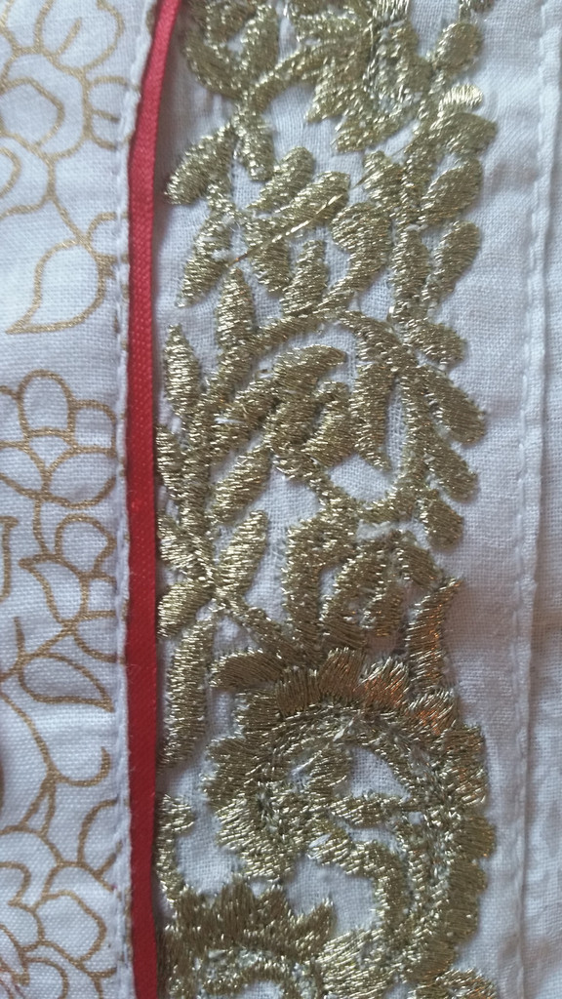
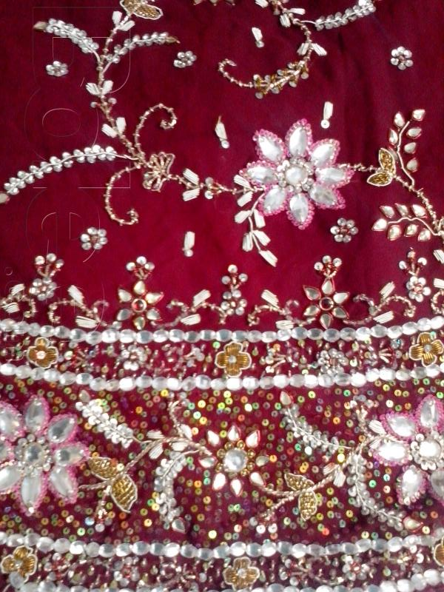
Tilla, Salma & Sitara work

Slide 22
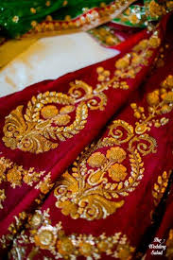
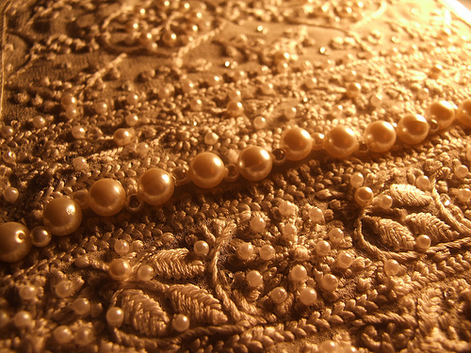

Slide 23
Chiatrali dress

Slide 24
Similarly, sheesha or mirror work has also been used to decorate fabric. Sewing mirror into a design is hard enough, but when you combine elements of design and pattern into it, as well as bright, beautiful colors, it transforms the piece into an immediate piece of art.
These days, a lot of embroidery is done by machines. But the intricacy of hand-embroidery is still unbeaten.

Slide 25
Kashmiri stitch

Slide 26
Balochi Stitch

Slide 29
Embroidered cover from Hunza

Slide 30
Sindhi Stich

Slide 33
Sindhi Stitch

Slide 34
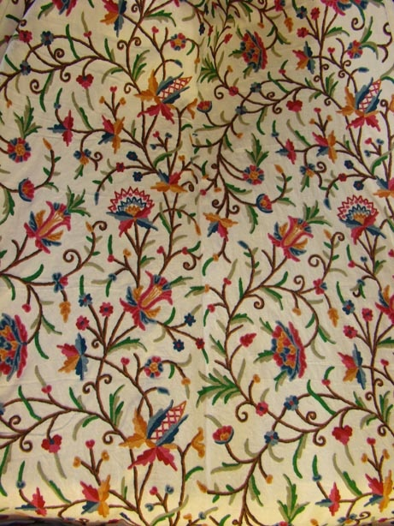
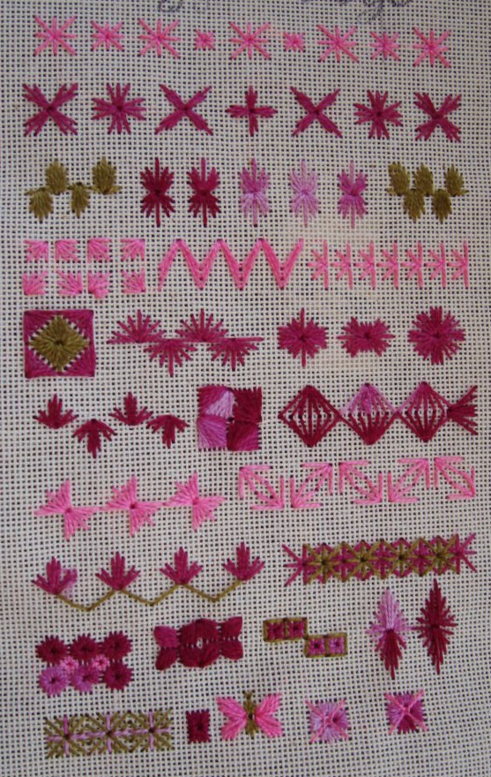

Slide 35
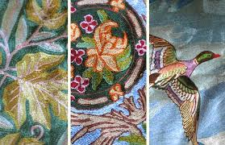
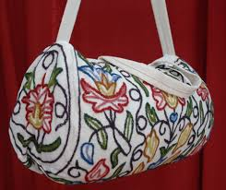

Slide 37
Desert Thar lady

Slide 38
Royal crafts produced and flourished in Urban areas
Tiles
Wood work
Ivory
Nakashi
Silver and gold work
Architectural craft
Carpets

Slide 39
Multani Art: Blue Pottery and Tiles
The history of Multani arts and crafts also goes back to medieval period.
KashiKari work, glazing and hand painting of ceramic products is an important art for which Multan is famous the would over.
The use of foliage branches and leaves of trees and superb richness of colours (mainly blue) in Kashi work is an evidence of Persian influence

Slide 40
The highest quality Multani tiles have been used in shrines, mosques and other important buildings including house ever since. The shrines of Shah Yousaf Gardezi (1153), Shah Rukne Alam, Ali Akbar, mosque Nawaban, Shrines of Uchh Sharif in Cholistan and Talpur tombs in Sindh are classic examples of tile work.

Slide 44
Tomb of Shah Rukn-e-Alam

Slide 45
Uchh Sharif Shrines

Slide 47
Chiniot Wood Carving
Chiniot is famous world-wide for the quality and intricacy of its wood carving.
The carvers of Chiniot have achieved a level of craft and creativity and good that other artisans in Pakistan and around the world can only hope to attain.
A special kind of furniture and brightly colored lacquered woodcarving is made in chiniot. Tables, beds, swings and so on.

Slide 52
Hand painted camel skin

Slide 57
Camel skin painted lamps

Slide 58
Camel bone Products

Slide 65
Salt Sculptures of Khewaora & Khushab

Slide 70
Lacquer work

Slide 75
Mojari or Khussa
Mojari or Khussa is a style of South Asian handcrafted footwear produced in Punjab Pakistan and India.
Mojari are made by artisans mostly using vegetable-tanned leather. The uppers are made of one piece of leather or textile embroidered and embellished with brass nails, cowry shells, mirrors, bells and ceramic beads.

Slide 76
Khushas

Slide 81
Ivory

Slide 85
handicrafts

Slide 102
Truck ART
With its all colorful floral patterns, depiction of human heroes with creative aspect ratios, calligraphy of poetic verses and driver’s words of wisdom, this form of art is truly a part of Pakistani transport tradition.
These truck bodies are perfectly painted by the street artists who can be found at Truck stands all across the country.

Slide 103
Pakistani trucks are also used as means of displaying the owner or the Painter’s Poetic taste. It also serves as a calligraphic board as well as a notice board for public messages.

Slide 104
Truck art

Slide 107
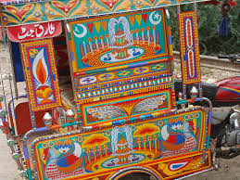

Slide 108
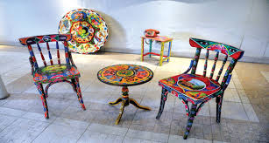
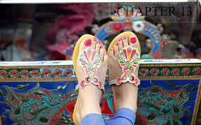

Slide 109
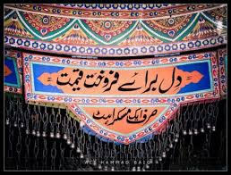
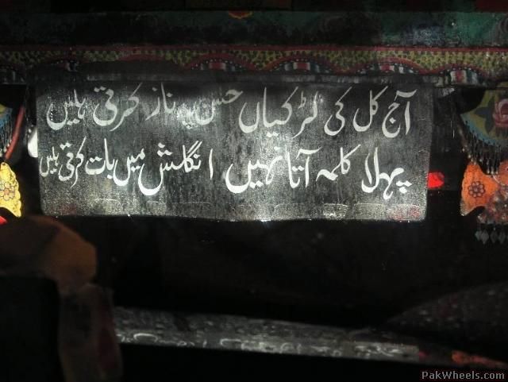

Slide 110
